Slide 1

AWS Messaging Services:
Amazon SQS vs. Amazon MQ
Decoupling and Scaling Your Cloud Applications

Slide 2
Why Messaging Matters in Cloud Architectures
In modern cloud-native and distributed systems, messaging services are not just an add-on; they are a fundamental component that underpins system stability, scalability, and responsiveness. They act as the central nervous system, ensuring that different parts of your application can communicate efficiently and reliably, even when faced with high loads or component failures.
Decoupling Microservices
Enabling Asynchronous Communication
Messaging services allow for loose coupling between microservices and distributed systems. Instead of direct, synchronous calls that can create tight dependencies and single points of failure, services communicate by sending and receiving messages via an intermediary queue or broker. This means a producer service doesn't need to know if the consumer service is available or how many instances are running, significantly enhancing system resilience and flexibility.
Asynchronous communication is critical for improving fault tolerance and overall performance. When a service sends a message to a queue, it doesn't wait for a direct response. This non-blocking behavior allows the sending service to continue processing other tasks immediately. If a consuming service fails, the message remains in the queue, ready to be processed once the consumer recovers, preventing data loss and ensuring eventual consistency. This pattern is particularly useful for long-running processes, batch operations, and event-driven architectures.

Slide 3
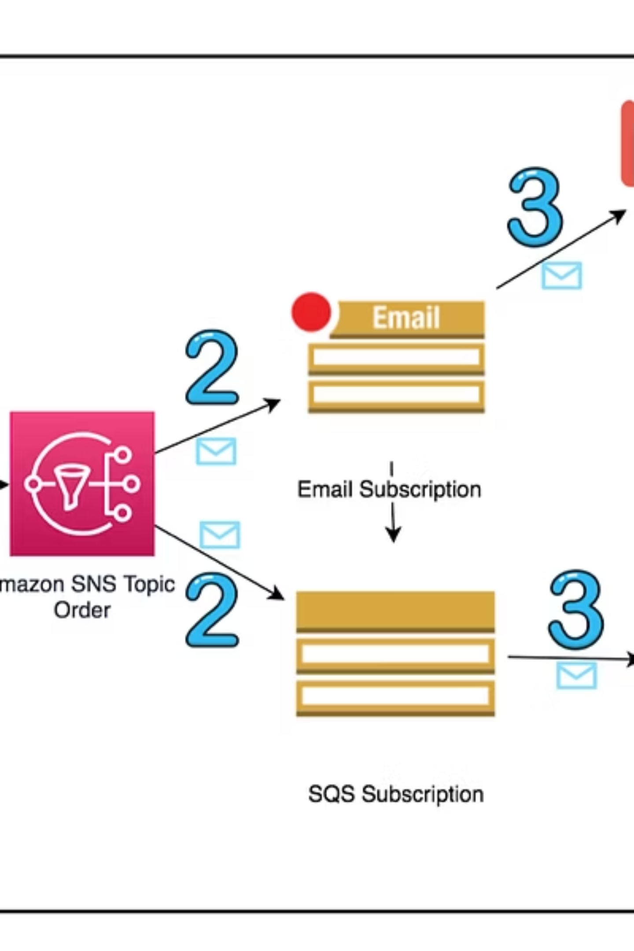
What is Amazon SQS?
Amazon Simple Queue Service (SQS) is a fully managed message queuing service that enables you to decouple and scale microservices, distributed systems, and serverless applications. As the first service launched by AWS in 2004, SQS has a long-standing reputation for reliability and scalability, making it a cornerstone for many cloud architectures.
Fully Managed & Highly Scalable: SQS handles all the operational heavy lifting, including infrastructure scaling, maintenance, and patching. You don't need to worry about provisioning servers or managing capacity; SQS automatically scales to meet your demand.
Queue Types: SQS offers two primary types of queues:
Standard Queues: Provide at-least-once delivery, meaning a message might be delivered more than once, but it is guaranteed to be delivered at least once. They offer maximum throughput for high-volume, non-ordered message processing.
FIFO (First-In, First-Out) Queues: Guarantee exactly-once processing and maintain the order in which messages are sent and received. This is crucial for applications where the order of operations and preventing duplicates are critical, such as financial transactions or inventory updates.
Built-in Features: SQS provides essential messaging features out-of-the-box, including:
Message Storage: Messages are stored securely until processed.
Visibility Timeout: Prevents other consumers from processing a message that is currently being handled, ensuring unique processing.
Dead-Letter Queues (DLQs): Automatically reroutes messages that fail to be processed after a certain number of attempts, allowing for easier debugging and error handling.
Encryption: Supports server-side encryption using AWS Key Management Service (KMS) for data at rest.

Slide 4




Amazon SQS: Key Benefits & Features
Amazon SQS stands out for its simplicity, cost-effectiveness, and deep integration within the AWS ecosystem, making it a go-to choice for cloud-native applications.
Automatic Scalability
Robust Security
SQS automatically scales to handle any volume of messages, from a few to millions per second, without requiring you to provision or manage servers. This elasticity ensures your application can handle peak loads seamlessly, without performance degradation.
Security is paramount with SQS. It supports server-side encryption (SSE) using AWS Key Management Service (KMS) to protect your sensitive message data at rest. Additionally, fine-grained access control can be managed via AWS Identity and Access Management (IAM), allowing you to define who can send or receive messages from your queues.
Seamless Integration
Cost-Effective Model
SQS offers native integration with a wide array of AWS services. It can act as a direct event source for AWS Lambda functions, enabling powerful serverless architectures. It also integrates with Amazon CloudWatch for monitoring, providing metrics on queue length, message age, and more. AWS SDKs are available for various programming languages, simplifying development.
With SQS, you pay only for what you use. There are no upfront fees or minimum commitments. You are billed based on the number of messages sent and received, as well as for data transfer, making it a highly cost-effective solution for a variety of workloads, from small-scale projects to massive enterprise applications.

Slide 5
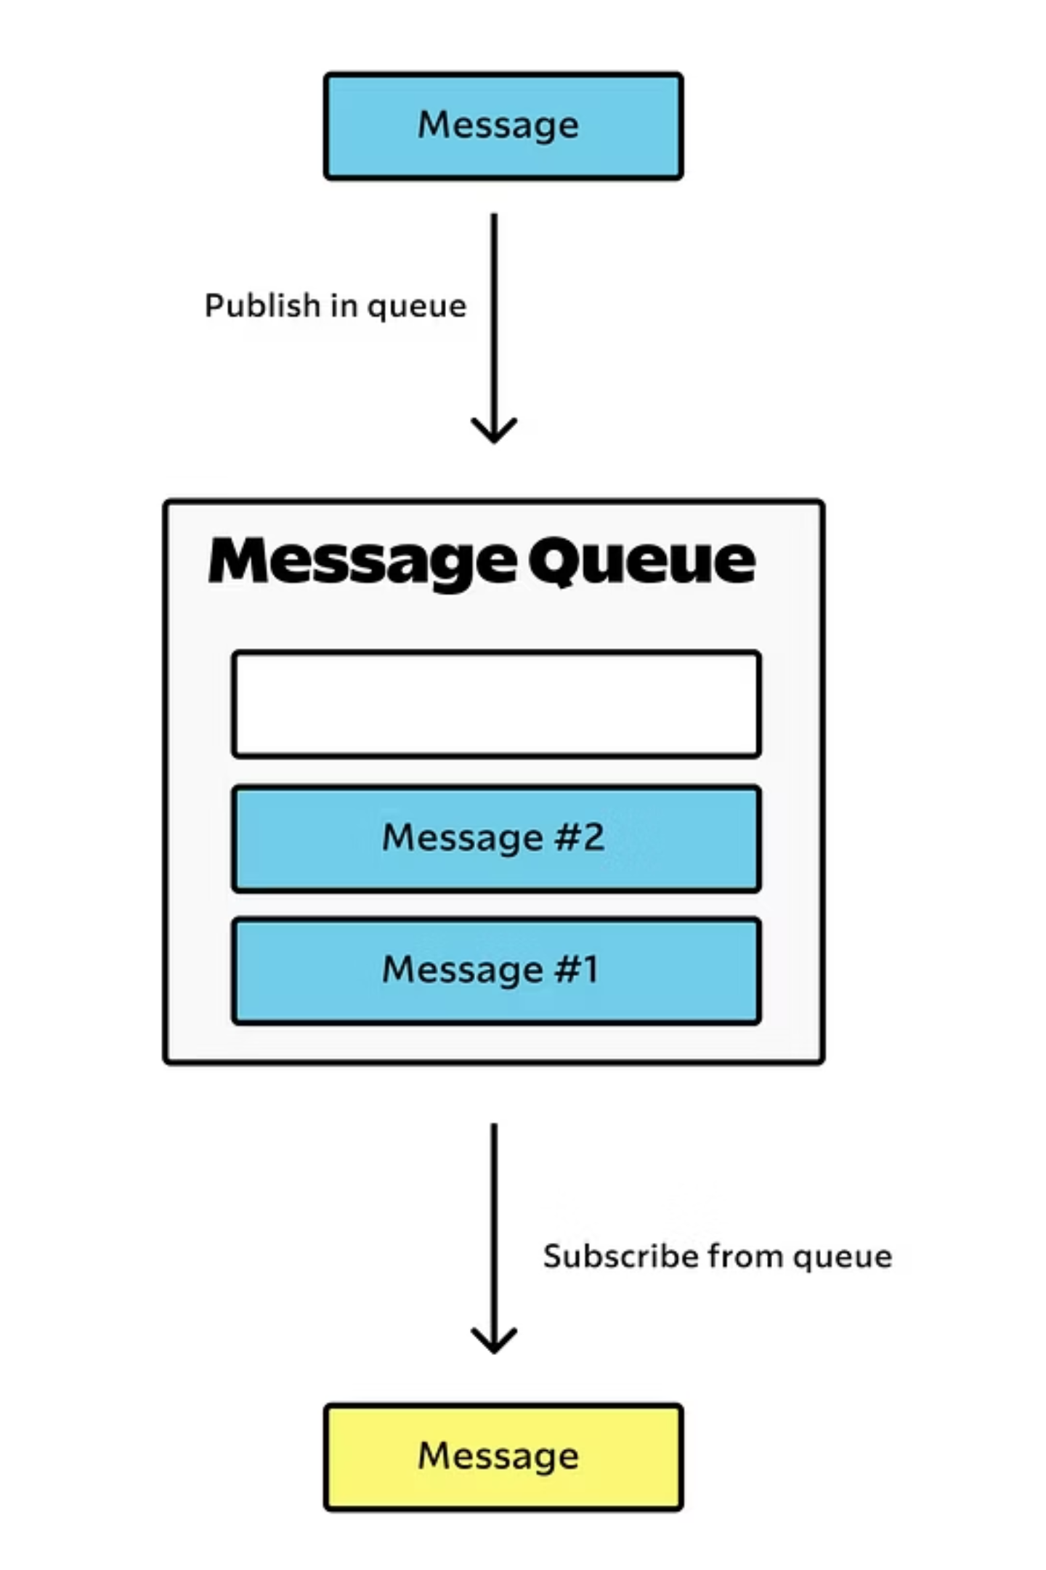
What is Amazon MQ?
Amazon MQ is a managed message broker service for Apache ActiveMQ Classic and RabbitMQ that makes it easy to set up and operate message brokers in the cloud. Unlike SQS, which is a message queuing service, Amazon MQ provides a full-fledged message broker, which offers more advanced messaging features and broader protocol support.
Managed Message Broker Service: Amazon MQ provides a fully managed environment for popular open-source message brokers, specifically Apache ActiveMQ Classic and RabbitMQ. This means AWS handles the provisioning, patching, backups, and monitoring of your broker instances, allowing you to focus on your applications rather than infrastructure management.
Simplified Migration: One of the primary use cases for Amazon MQ is migrating existing applications from on-premises message brokers to the cloud. Because it supports widely used open-source brokers and industry-standard protocols, you can often lift and shift your existing messaging logic without extensive code changes, significantly reducing migration effort and risk.
Industry-Standard Protocol Support: Amazon MQ distinguishes itself by supporting a wide range of industry-standard messaging protocols, making it highly compatible with existing enterprise applications and legacy systems:
AMQP (Advanced Message Queuing Protocol): A robust, open standard for message-oriented middleware.
MQTT (Message Queuing Telemetry Transport): A lightweight messaging protocol ideal for IoT devices and mobile applications.
JMS (Java Message Service): A Java API for sending and receiving messages, commonly used in enterprise Java applications.
OpenWire: ActiveMQ's native binary protocol.
STOMP (Simple Text-Oriented Messaging Protocol): A text-based protocol for working with message brokers.

Slide 6
Amazon MQ: Key Benefits & Features
Amazon MQ is designed for scenarios requiring the power and flexibility of a traditional message broker, particularly for hybrid cloud deployments and complex enterprise integrations.
1
2
Broker Management
High Availability
AWS automates the time-consuming tasks of managing message brokers, including software upgrades, security patching, and daily backups. You can monitor your brokers' health and performance metrics via Amazon CloudWatch, allowing you to focus on application development rather than operational overhead.
For mission-critical applications, Amazon MQ supports high availability configurations. You can deploy brokers across multiple Availability Zones (Multi-AZ) to ensure continuous operation even if one zone experiences an outage. RabbitMQ brokers support quorum queues for data consistency and ActiveMQ supports cross-region replication for disaster recovery.
3
4
Enhanced Security
Advanced Messaging Patterns
Amazon MQ provides comprehensive security features. Messages are encrypted in transit using SSL/TLS and at rest using AWS KMS. Access control is managed through AWS IAM, allowing precise control over who can interact with your brokers. You can also deploy brokers within an Amazon VPC for network isolation and enhanced security.
Amazon MQ is ideal for applications requiring more complex messaging patterns than simple queues. This includes support for publish/subscribe topics, request/reply patterns, message routing rules, and message filtering, which are often essential for enterprise application integration and microservices communication in intricate architectures.

Slide 7
SQS vs. MQ: When to Use Which?
Choosing between Amazon SQS and Amazon MQ depends heavily on your specific application requirements, existing infrastructure, and desired operational model.
Use Amazon SQS When:
Use Amazon MQ When:
You are building new cloud-native applications, especially those using serverless architectures (e.g., AWS Lambda).
You are migrating existing applications from on-premises message brokers (like ActiveMQ or RabbitMQ) and want to avoid rewriting code.
You need a simple, scalable, and highly available message queue without managing broker infrastructure.
Your application requires advanced broker features such as publish/subscribe topics, complex routing, message filtering, or durable subscriptions.
Your application can tolerate at-least-once delivery (Standard queues) or requires ordered, exactly-once processing (FIFO queues).
You prioritize cost-effectiveness with a pay-per-message model and minimal operational overhead.
You need compatibility with industry-standard messaging protocols (AMQP, MQTT, JMS, OpenWire, STOMP) that are not natively supported by SQS.
Your use case primarily involves decoupling components and enabling asynchronous communication without complex routing logic.
Your developers are already familiar with open-source message brokers and prefer working within that paradigm.
You need fine-grained control over broker configuration and network security, while still benefiting from AWS-managed operations.
While both services improve decoupling, SQS offers simplicity and native cloud integration, whereas MQ provides a more traditional broker experience for complex needs and seamless migration.

Slide 8
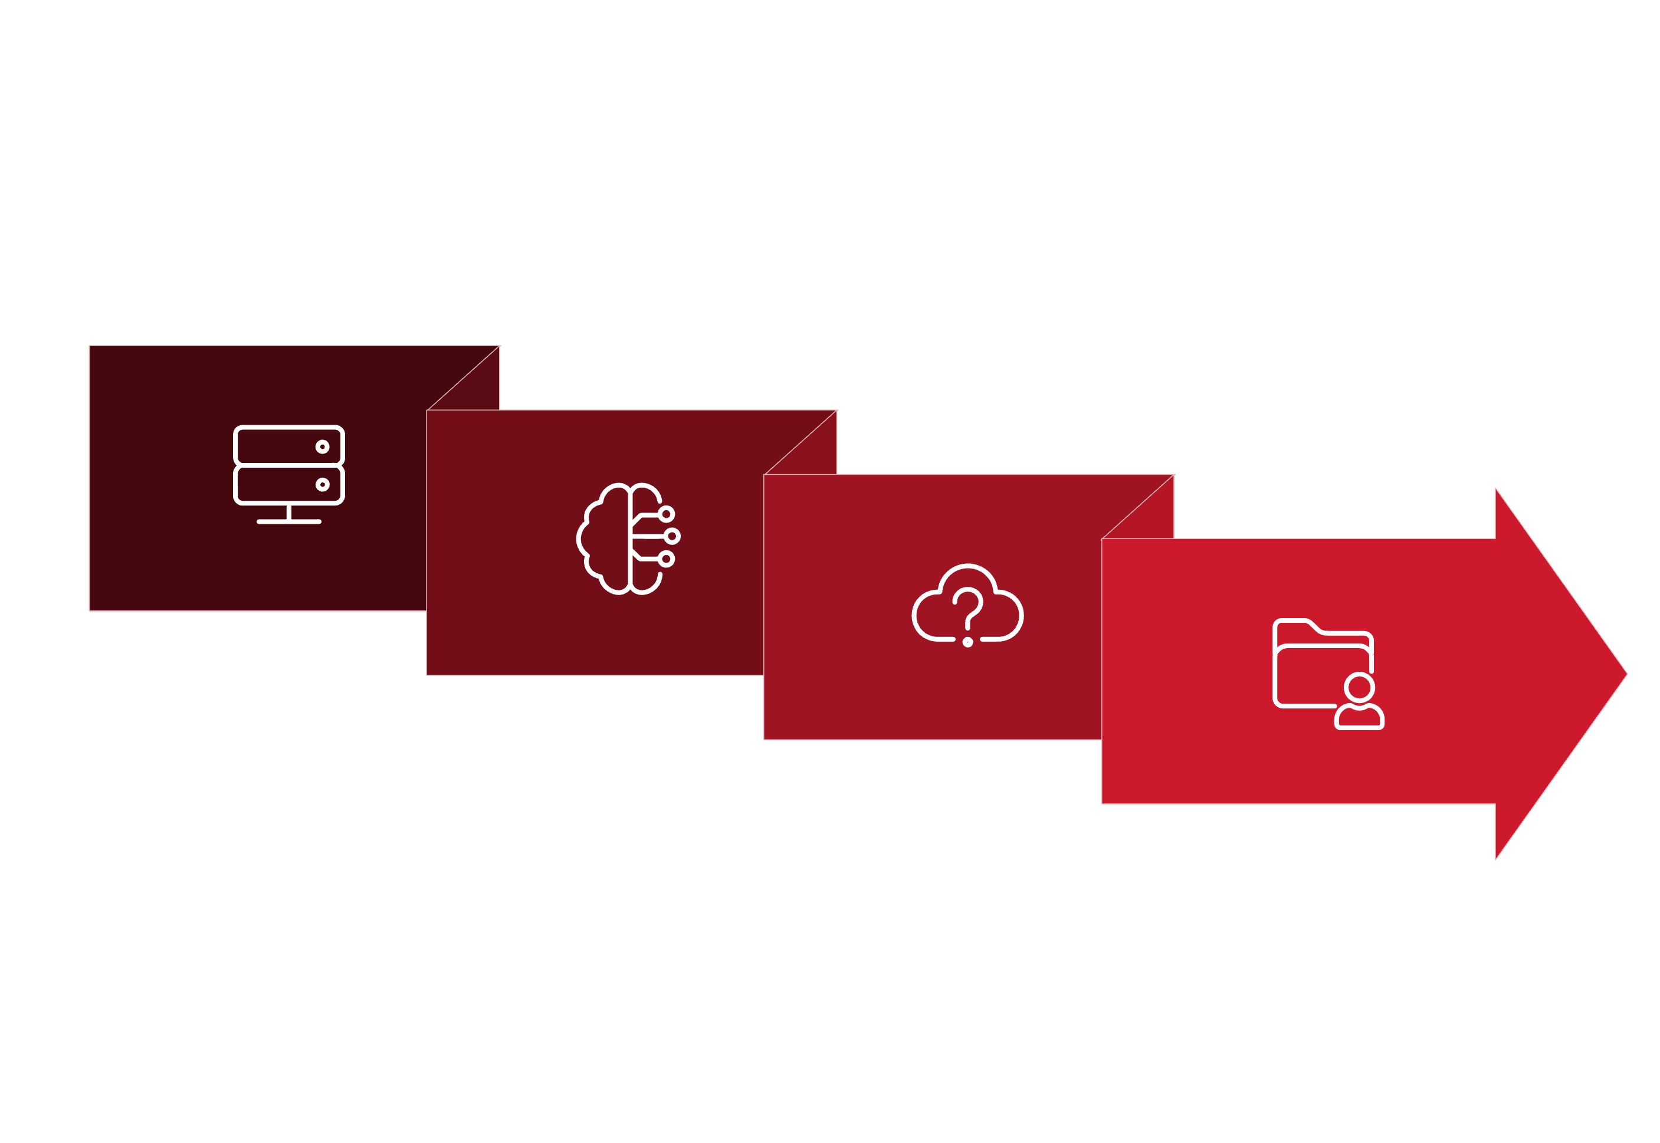




Real-World Integration Example: Hybrid Messaging
A common challenge for enterprises is integrating legacy on-premises systems with new cloud-native applications. This often involves bridging traditional messaging middleware with AWS services.
Apache Camel
S3 / DLQ
IBM MQ (On‑Prem)
AWS Messaging
Consider a scenario where an enterprise has a significant investment in on-premises IBM MQ infrastructure but wants to leverage the scalability and flexibility of AWS.
Bi-directional Bridge with Apache Camel
Handling Large Messages & Failures
Apache Camel, an open-source integration framework, can be used to build a robust bi-directional bridge. This allows messages to flow seamlessly between on-premises IBM MQ and various AWS messaging services like Amazon MQ, SQS, and SNS (Simple Notification Service). Camel’s extensive component library provides connectors for both IBM MQ and AWS services, simplifying the integration logic.
S3-backed Storage: For large messages exceeding typical queue size limits, the solution can integrate with Amazon S3. Message metadata is sent through the queue, while the actual large payload is stored in S3, with a reference passed in the message. This prevents message size limitations and improves queue performance.
Dead-Letter Queues (DLQs): Implementing DLQs for both on-premises and cloud queues is crucial for handling failed message processing. Messages that cannot be delivered or processed after multiple retries are moved to a DLQ, allowing operations teams to inspect, debug, and manually intervene without blocking the main message flow.

Slide 9


Architectural Patterns with SQS & MQ
Both SQS and MQ can be combined with other AWS services to build powerful and resilient architectural patterns.
Fanout Pattern
Event-Driven Serverless
Hybrid Migration
Utilize Amazon SNS (Simple Notification Service) topics to publish a message once, and then fan it out to multiple Amazon SQS queues for parallel processing by different downstream services. This is highly effective for broadcasting events or updates to multiple subscribers.
SQS can directly trigger AWS Lambda functions. This pattern allows for scalable background processing of events (e.g., image resizing, data processing, email notifications) without provisioning or managing any servers, scaling automatically with incoming message volume.
For gradual cloud adoption, you can implement a hybrid migration strategy where existing on-premises MQ brokers communicate with new Amazon MQ brokers. This minimizes downtime and risk by allowing a phased transition of applications to the cloud.
These patterns demonstrate the versatility and power of AWS messaging services in creating adaptive and high-performance cloud applications.

Slide 10
Conclusion:
Choosing the Right AWS Messaging Service
AWS offers powerful messaging solutions tailored for different needs. Understanding their distinct advantages is key to building resilient and scalable architectures.
Amazon SQS
Amazon MQ
Lightweight and Fully Managed: Ideal for serverless, microservices, and event-driven architectures where you need robust queues without operational overhead.
Managed Broker for Complex Needs: Best suited for migrating existing applications that rely on open-source brokers like ActiveMQ or RabbitMQ.
Scalability by Design: Handles any message volume automatically, ensuring consistent performance.
Protocol Compatibility: Supports industry-standard protocols (JMS, AMQP, MQTT, etc.), reducing the need for code changes during migration.
Cost-Effective: Pay-as-you-go model makes it economical for a wide range of use cases.
Advanced Messaging Features: Offers topics, routing, and other broker-specific functionalities for intricate integration patterns.
By leveraging the comprehensive AWS integration ecosystem, you can combine SQS, MQ, and other services like SNS, Lambda, and S3 to construct highly resilient, scalable, and secure distributed applications that meet your business requirements. The choice between SQS and MQ is not always exclusive; in complex environments, they can often be used in tandem, each serving its optimal purpose within a broader messaging strategy.

